Slide 1
Understanding College Award Letters & Financial Aid Packages

Slide 2
Introductions
Our GEAR UP Team includes:

Slide 3
What do we mean when we say college?
When we say “college”, we mean any type of education or training after high school. We also use the terms “postsecondary education” and “postsecondary training”.
There are many options for students after high school, including apprenticeships, military, on-the-job training programs, community college certificates, two-year degrees, and four-year degrees.
The term college includes all of these things.
Notes:
Many people think college is just a four year program, but there are many options. We want students to find the right fit. Explain that this is called “postsecondary education” because it is after (or “post”) high school (secondary education). Postsecondary education is often called “college”. College can be 4-year university, 2-year college or technical college, military training, certificate programs, or apprenticeships. Each of these paths has entrance requirements. These requirements vary by institution.

Slide 4
March & April Overview
Review acceptance letters and financial aid awards.
Decide where to go and send required materials to college.
Scholarships – keep applying!
Notes:
In March and April, students will start receiving acceptance letters and financial aid award packages from four-year colleges. They should make their choice, keeping in mind that their dream school may not be the one that offers the most aid. Students should make sure they are making the choice that is the most affordable and best fit for them.
After making their decision, students should send in any required deposits or housing decisions. These can vary from $200-$400 depending on the school. If the deposit is a financial hardship for the student, the student should call the college admissions office and the financial aid office to see if there are other options. It may be possible to defer the deposit to the fall so it can be paid out of the student’s financial aid package.
Students should make sure they meet the response deadlines set by each college, to ensure that materials make it to the college on time.

Slide 5
March & April: Award Letters
Award Amount (scholarships, grants, loans, work study)
Cost of Attendance
Expected Family Contribution
Financial Need vs. Total Award Amount
Option to accept, reduce, or reject
Notes:
Need is the difference between the cost of attendance and the EFC. The need determines how much aid a student is eligible to receive, as this is the amount the college will try to match with available aid.
A financial aid award letter will also contain the award package, which is an outline of the different kinds of aid and the amounts that are being offered to the student. Scholarships, grants, work-study and loans will be on the award package.
The total award will be listed. This is the sum of all of the package component amounts.
The gap is any unmet need that remains between the cost of attendance and the award.
Award letters also give the student the option to accept, reject, or reduce different parts of the package.

Slide 6
March & April: Evaluating Award Letters
How much is in “free money” (scholarships and grants), versus loans? What would the total loan debt be at each college?
How do I access work-study?
After required expenses are taken out (tuition & fees, room & board), how much is left for the rest of the term to cover other expenses, like books?
Are the scholarships I’m receiving renewable? Or just a one-time thing?
What do I need to do to maintain Satisfactory Academic Progress (SAP) in order to keep my financial aid?
Notes:
I always encourage students to call the financial aid office and ask questions. As you’re working with students and families, these are some questions I suggest as a guideline to work through their letters.
The first thing students should be aware of is what is on their financial aid package. How much of it is in scholarships and grants versus student loans? What would be the total loan debt at each college they’ve received a financial aid package to?
If students have work-study, it’s a good idea for them to know how to access it. Most colleges and universities have an office that handles work-study jobs.
After required expenses are taken out, how much is left for the rest of the term to cover other expenses, like books? It’s always a good idea to remind students that once the money disbursed to their account is gone, it may be difficult to get any more that quarter (barring something like emergency medical expenses). And, if they have to ask for more aid, it usually comes in the form of a student loan. Students should practice careful budgeting to make sure their financial aid gets them through the term.
A renewable scholarship is one that a student receives every year he or she is in college. If any institution-specific scholarships are on the award letter, it’s a good idea to ask if those scholarships are renewable or just a one-time thing.
Students also need to be aware of Satisfactory Academic Progress. If they don’t pass enough credits, there is a possibility that they may not receive aid for the next quarter. Students should always be aware of what they need to do to maintain Satisfactory Academic Progress in order to keep their financial aid, and each college has a different SAP policy.

Slide 7
May 1 – Decision Day for Four-Year Colleges
To made good financial decisions, students and families need to know:
Cost of Attendance (COA) of all colleges and the “net cost” of each.
Financial Aid available to the student from all colleges:
Grants and scholarships (gift aid).
Self-help program options for students.
Work study employment opportunities.
Low-interest government loans.
Payment plans and loan options to parents.
Notes:
Community colleges have rolling deadlines.

Slide 8
EFC and Financial Aid Eligibility
Expected Family Contribution (EFC) is determined on an annual basis after the Free Application for Federal Student Aid (FAFSA) or Washington State Application for Financial Aid (WASFA) has been completed.*
FAFSA filers receive their EFC amount when they receive their Student Aid Report (SAR).
Student and family contributions are not always limited to the EFC amount. Financial aid funding is limited; students and families often end up contributing more than their EFC each year.
*Note: The Washington State Application for Financial Aid (WASFA) should be completed by DREAMers – eligible undocumented students.

Slide 9
Cost of Attendance (COA)
The TOTAL estimated cost associated with enrolling at a school for a specific enrollment period.
Usually full time for a full academic year.
Set by each school.
May include dependent care costs, computer, uniforms, (at school’s discretion).
Direct costs: School’s tuition and fees (and on-campus housing costs, if applicable).
Indirect costs: Books, personal, and transportation costs typically not paid to the school.
Notes:
The school will build a COA on the student’s living arrangements, course load, academic program, and length of attendance. Most schools will use an average COA, but can modify costs on a personal basis.

Slide 10
COA Variables
Tuition and fees
Housing & Food Costs
Books & Supplies
Personal
Transportation
Full-Time vs. Part-Time, 1, 2, or 3 quarters or semesters, fees (generally listed separately).
On or off campus or living at home.
Purchase or rent, new or used, from school bookstore or online.
Average amount, varies by life style choices.
On or off campus, living at home. Availability of mass transit, cannot include car payments.
Notes:
COA are typically for full time enrollment for the entire academic year, but can be built for <FT and for shorter terms of enrollment. It will not, however, exceed a 12 month academic year. If the student is living at home, the financial aid COA recognizes that there are costs associated with living at home, even though they may be at least partially absorbed by the parents.

Slide 11
How is COA used to determine financial aid (eligibility)?
Cost of Attendance (COA)
Expected Family Contribution (EFC)
Estimated Financial Need

Slide 12
Breakdown of average COA in Washington State: 2015-16
 | 2 Yr. Community Colleges AA Degree | 4 Yr. Public Universities BA Degree | 4 Yr. Private Universities BA Degree
Tuition & Fees | $4,271 | $9,612 | $32,370
Housing & Meals | $9,739 | $10,517 | $10,621
Book & Supplies | $1,063 | $1,005 | $1,089
Personal & Trans. | $3,321 | $3,343 | $3,081
TOTAL | $18,349 | $24,477 | $47,161

Slide 13
Step 3: Financial Aid Award Letters
We will look at a two sample award letters from a public four-year and a private four-year college and will provide information on how to compare aid offers.
Come in many formats – no standardization!
Generally not easy to compare from one college to another.

Slide 14
Sample Award Letter:
4-Year Public Universities – A ($0 EFC)
Cost of Attendance
Type & amount of aid
Additional & Contact Information
Notes:
This student’s tuition costs if fully covered by the State Need Grant and College Bound scholarship. The federal Pell Grant and the academic scholarship is available to cover a significant portion of the student’s living costs and student can see that loans and work study are available to meet 100% the other educational costs – since the COA is provided on the award letter. This is a great aid award.

Slide 15
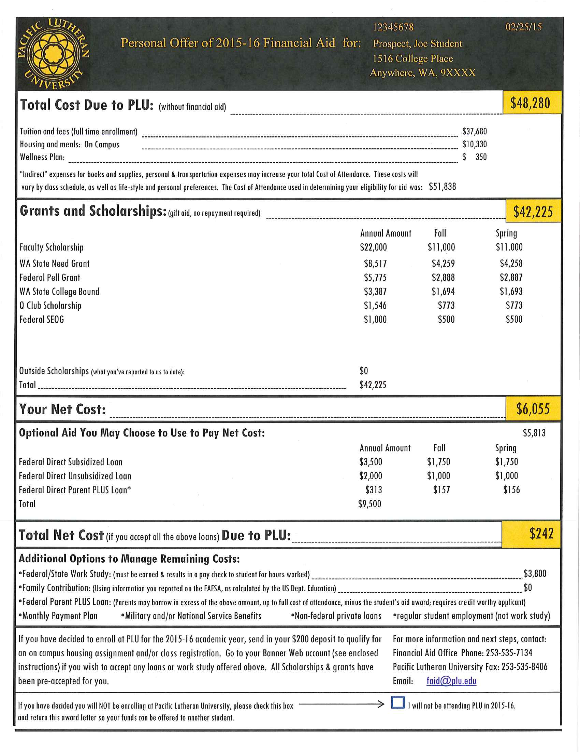
Sample Award Letter:
4-Year Private Universities – A ($0 EFC)
Direct Costs
Type & amount of aid
Total Cost of Attendance
Additional & Contact Information
Notes:
This student’s tuition and fees are covered by scholarships and grants and has loans and work study available to help pay for on-campus living costs. The family wouldn’t have out-of-pocket costs unless student could not earn the full amount of their work study award – so potential sources of additional resources are provided. “Bottom line” – what owed to the school is provided. In all of these examples, award letter would change if the student had a different living arrangement because their cost of attendance would be different.

Slide 16
For comparison, make a spreadsheet to compare: Cost of Attendance Total Gift Aid Total Student Loans Awarded Work Study The ‘bottom line’ then shows the additional contribution, if any, that the student and parents need to make to meet the full COA.

Slide 17
Free Online Comparison Tool
BigFuture: https://bigfuture.collegeboard.org/pay-for-college/financial-aid-awards/compare-aid-calculator

Slide 18
Free Tools
More Resources:
Award Letter Worksheets (fillable forms)
Key components
Living on campus
Living off campus
College Knowledge Chapter 4: Paying for College
Find on: https://readysetgrad.wa.gov/educators/grad/information-educators-and-volunteers

Slide 19
Can the Student Afford It?
Are the student loan amounts reasonable? (The average Washington four-year college graduate who borrows takes about $25,000 in loans for undergraduate.)
Are the Total Out-of-Pocket Costs (COA less Total Financial Aid) reasonable for the student and parents to afford each year?
Is the student able to earn part or all of the difference from work study or other employment earnings?
Are there other private scholarship sources the student might yet receive?
Financial aid options for parents?
Notes:
How much are the parents willing and able to contribute to EFC?
Are the parents willing and able to borrow to assist? If yes, will the parents be able to continue that borrowing for all undergraduate years?
Direct contributions from parent income, assets, or other accounts such as Guaranteed Education Tuition (GET).
College payment plans spread over a number of months.
Other types of longer-term borrowing:
Federal Parent PLUS Loans
Other Private Loans

Slide 20
Questions About Financial Aid Awards?
Students and families should contact the Financial Aid Office (FAO) at the colleges:
If the family financial circumstances have declined since they filed the FAFSA or WASFA (e.g. Loss of employment of a family member).
If the award offer is not affordable, let the FAO know – they might be able to provide other advice or additional assistance.
Sometimes it is hard to get through by phone to the FAO. Be persistent!
Notes:
Note: With the FAFSA using tax documents from two years prior this can significantly impact their award letters. It is important to update the FAO with any circumstance changes.

Slide 21
Students Must Reapply Each Year
Submit the FAFSA or WASFA in October each year! College freshman will fill out their second FAFSA or WASFA in October 2017!
Consider the merits of work study and other employment and internship possibilities.
Get to know your FAO staff!
Apply for other aid and scholarship programs whenever possible.
Consider the financial aid process a “part-time job” where you work to keep COA affordable and to keep student loan debt as low as possible!
Notes:
Focus on next October, remember they need to reapply.
Institution might be able to provide assistance when reapplying. Also check with your HS or the 12th Year Campaign event list online.

Slide 22
Two Suggested Resources
Financial Aid 101
Use this guide to learn how you can begin finding and applying for money to finance your education!
http://gearup.wa.gov/resources/washington-state-gear-resources
ReadySetGrad
www.readysetgrad.org/college/financial-aid-101

Slide 23
The WashBoard – Free Scholarship Search for Students
www.thewashboard.org

Slide 24
Scholarship Search Engines/Banks
TheWashboard.org
Gearup.wa.gov
Bigfuture.collegeboard.com
Collegegreenlight.com
Unigo.com
Scholarship Junkies’ Scholarship Bank
My College Dollar$
Scholarship 360
Fastweb.com
Scholarships.com
Notes:
Beth

Slide 25
March & April: Making the College Choice
Visit campus
The “Right Fit” (size, location, etc.)
Degree programs
Financial aid package
Weather
College paper
Notes:
So how does a student make the choice about where to go? One of the best ways to figure this out is for the student to visit campus. But this isn’t always financially feasible for all students. As a result, I suggest they go back and look at the list of factors they identified as being important to them in a college. Of the colleges they’re choosing between, which has most (if not all) of the factors that the student identified as being essential to having that right fit?
Students should look at degree programs to make sure that the college has the degree or program they want.
Affordability is a huge consideration here. You may have to gently remind students that their “dream college” may not be the most affordable to them. That means that students may have to make a really tough choice.
It may sound silly, but students may want to give some thought to the weather at the college. Some colleges in the Midwest are so cold and snowy in the winter that students have to use underground tunnels to get to and from their classes. Will a student be comfortable at the college, or is the thought of a long winter daunting?
Also, check the college paper to get a pulse on what students at the college are concerned about at their college. The college paper, too, is also a great way for high school students to get an idea of what life on that particular college campus is like.

Slide 26
Senior/College Signing Day
Insert information on your school’s events

Slide 27
May & June Overview
May 1: National Candidates’ Reply Date
Thank you notes
Final transcript
College deadlines
Graduation!
Notes:
May 1st is the National Candidates Reply Date. According to NACAC best practices, no college can require students to commit to attending prior to May 1. Most colleges and universities will have the student make the decision online. If a student knows prior to May 1 where she wants to go, she should tell the college. You don’t want to wait until 11:59 PM on May 1 only to have technical issues!
While most colleges and universities do participate in the National Candidates Reply Date, many do not. Students always need to be aware of deadlines.
Send thank you letters to teachers, counselors, and references who helped. It’s a nice gesture, and makes them more likely to help you again in the future.
Students need to request that their final transcript to be sent to the college s/he plans on attending.
Finalize housing, deposits, orientation date and classes.
And finally, students graduate!

Slide 28
Summer Overview
College orientation
Two-year financial aid awards
Scholarship awards
Notes:
College orientation usually happens in the summer. Students should select a date that works best for them. Sometimes orientation happens right before school starts, but some colleges may do this earlier in the summer.
Students will typically receive notice of their two-year financial aid awards in the summer.
Also, late spring and early summer is a time when students often hear about their scholarship awards. Students should follow up with scholarship providers by sending them a thank you letter. It’s also a good idea to follow up annually with the provider of the scholarship they have been awarded, to update them on how they used the funds and see if there’s any available to support future years of study.

Slide 29
Up Next Mobile Messaging Campaign
Up Next will provide students and families across the country with personalized information and encouragement to complete important college and financial aid milestones and tasks.

Slide 30
Questions?

Slide 31
Thanks for coming
Contact information:
[insert counselor/advisor/mentor name]
Phone: (xxx) xxx-xxxx
E-mail: xxxx@xxxx.xxx

Slide 32
Next Family Night
Topic
Date

